Slide 2
Bonjour mademoiselle!
Wie geht es dir?
Wǒ hěn hǎo.
Dhanyavaad!
How Multilingual is Your NLP Model?
Shreya Khurana

Slide 3

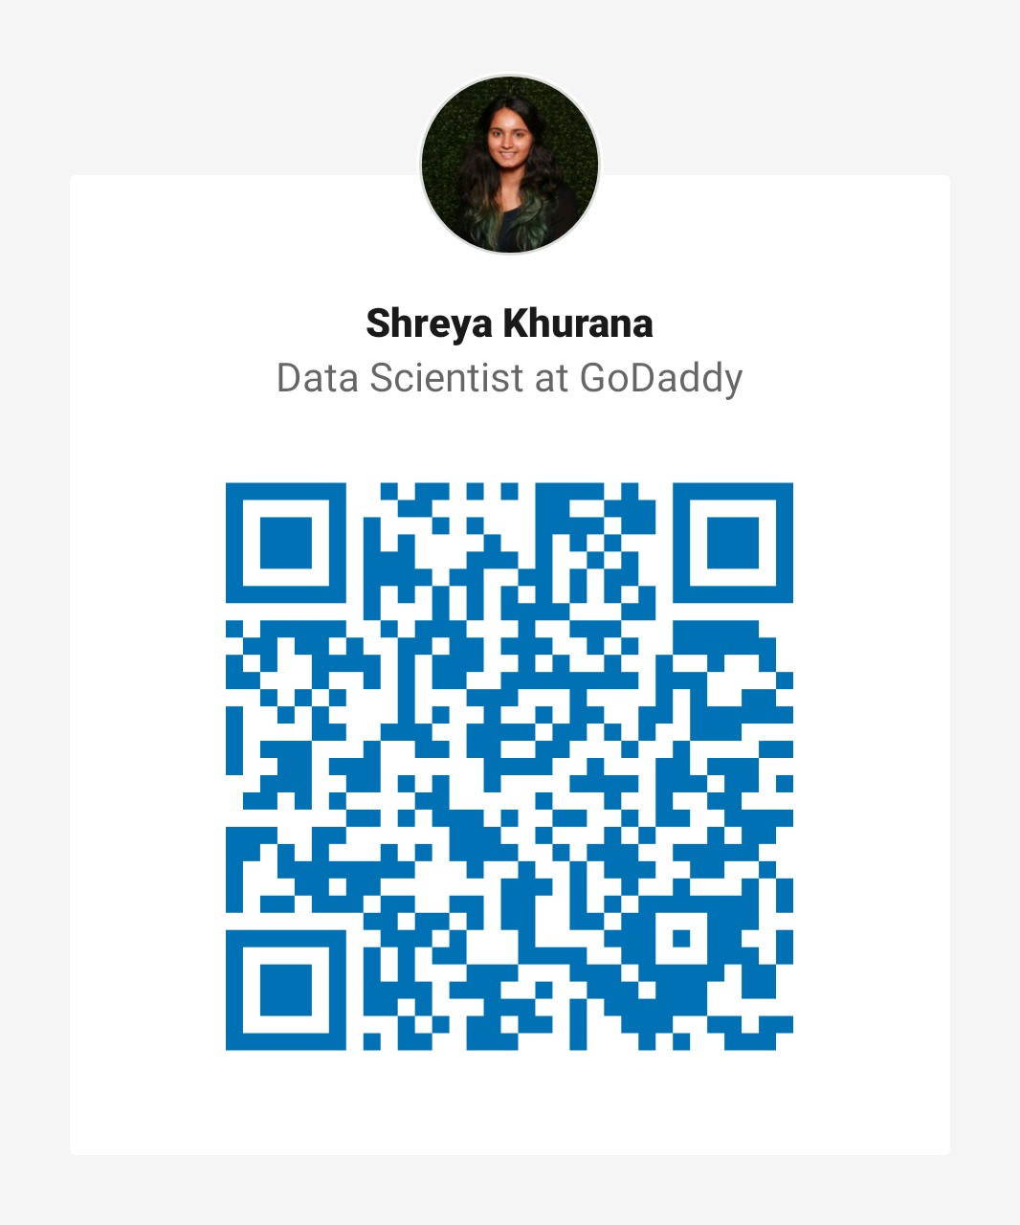

whoami
Senior Data Scientist at GoDaddy
Work with language data and ML models
PyCon 2020, EuroPython 2020, GeoPython 2019
Follow this presentation:
https://github.com/ShreyaKhurana/ghc2020

Slide 4
Outline
01
Why Go Multilingual?
02
How Do We Go Multilingual?
Where is Multilingual Modeling going?
03
Notes:
we're going to divide the presentation into three parts,

Slide 5
Why Go Multilingual?
Привет !
Hallo!
Salut!
Ciao!
Bonjour!
नमस्ते !
Hello!
مرحبا
你好
ہیلو
Hola!
Hi!
Mhoro!
Olá!
Notes:
7 billion people, 6800 languages in this world, 193 countries. 1.6B people speak Mandarin, 500M people speak Hindi, 560M people speak English, 490M people speak Spanish
As of Jan 2020, while majority users do speak or understand English at some level, 20% of the internet users speak Chinese, 8% speak Spanish, 5% speak Arabic,
But the reason I brought on the slew of random numbers at you, is to show that despite a large population speaking other languages, using them in their daily conversations, messages, chats, it is only recently that we’ve begun to explore how we can make sure the models we’re using are not only biased but can also be used by all.

Slide 6
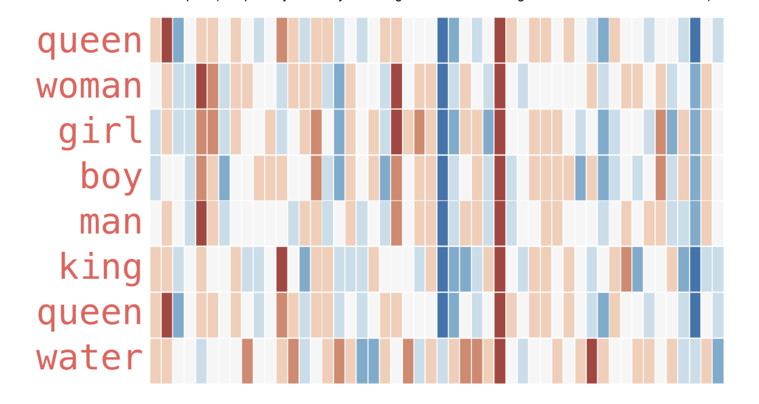
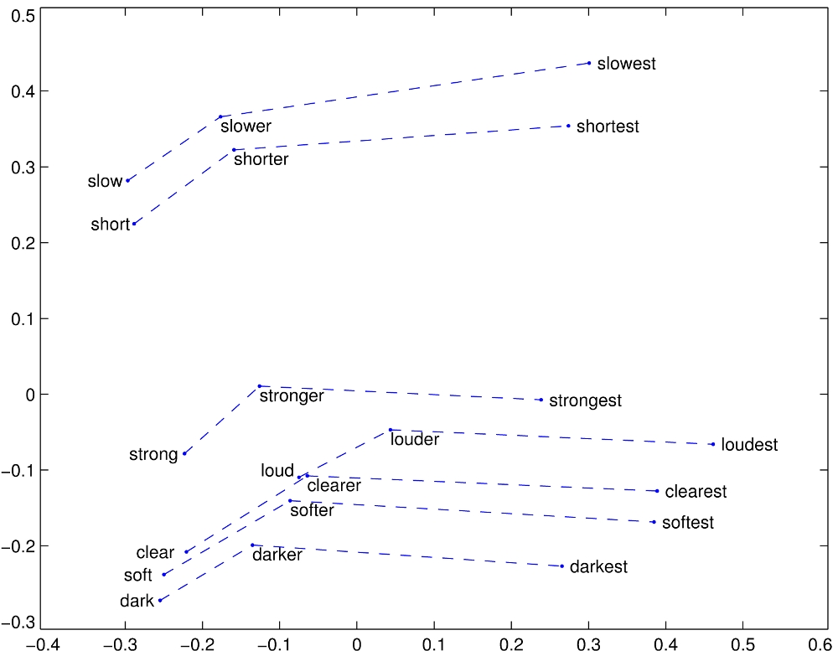
Off-the-shelf Models
Word2Vec
GloVe
Source: http://jalammar.github.io/illustrated-word2vec/
- Pre-trained embeddings available for English words
- Works on monolingual corpus
- Need large corpus to train for new languages
Source: https://nlp.stanford.edu/projects/glove/
Notes:
Word embeddings give us a way to use an efficient, dense representation in which similar words have a similar encoding. It’s the first piece we usually start with when building NLP models
The pre-trained embeddings we have available are usually in English, because they’re made of huge corpii like Google News for word2vec and Wikipedia, common crawl
Glove is with 1B+ tokens

Slide 7
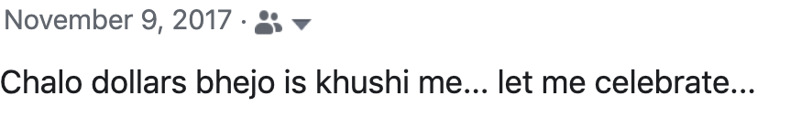
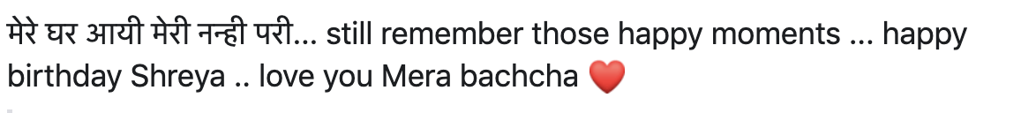
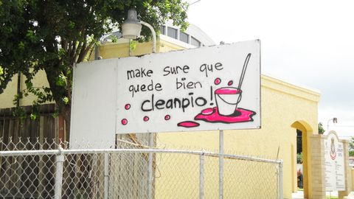
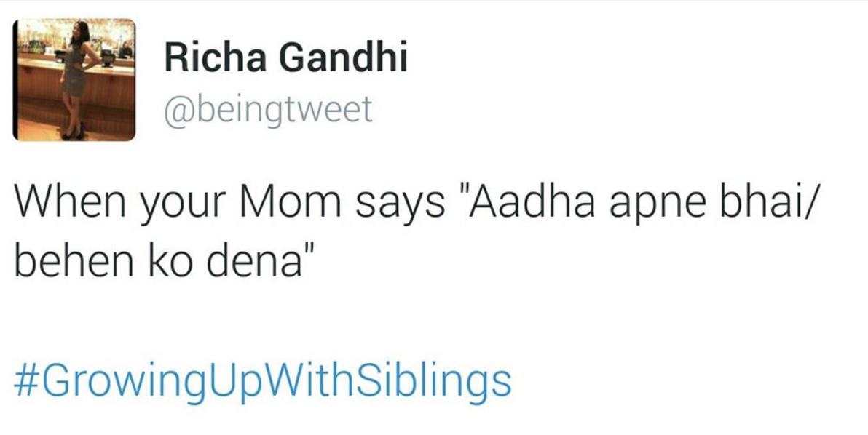
Code-Switched Data
Transliterated
Alternating between two languages in the same sentence/ conversation
English
Native script
Source: https://www.cosmopolitan.com/lifestyle/a5547/spanglish-words/
Source: My Facebook timeline
Notes:
Advertisements
Tweets, facebook posts, memes
Dialogues, movies , lyrics, they all make a huge part of the internet
Daily conversations
Explain color scheme of highlighted parts

Slide 8
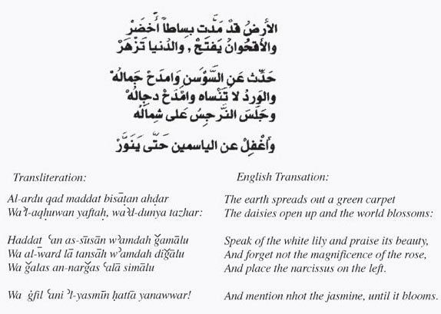
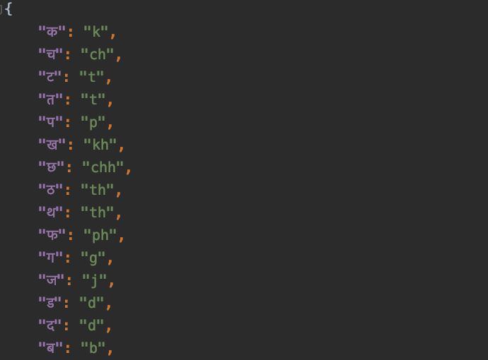
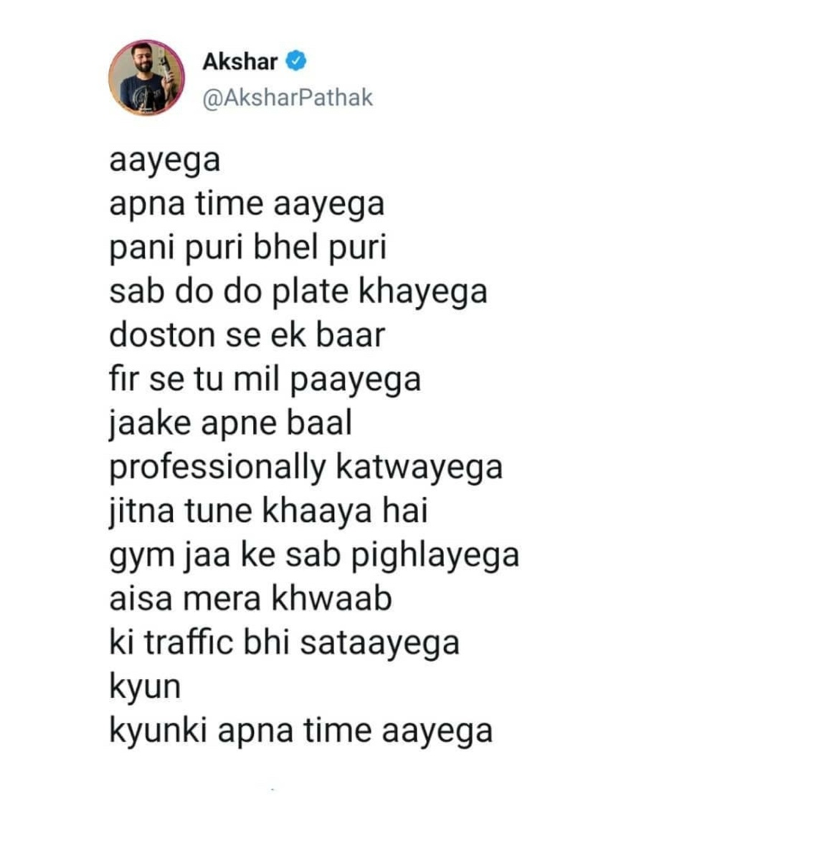
Transliterated Data
Converting words written in alphabet of one language to another
Often can be converted through rules
Source : Twitter (https://twitter.com/AksharPathak/status/1268772245368909825?s=09)
Source: https://arabicpoetry-love.tumblr.com/

Slide 9
Language Detection Frameworks
cld3, langid, langdetect
Notes:
When we talk about this kind of data, even if we gather it, collect it the first step is to detect which languages it’s from and because as we saw, there are phrases of small length of different languages, so it’s even more difficult, as we’ll see in the coming examples
We’ll talk about the challenges we face by using some of the frameworks available open source

Slide 10
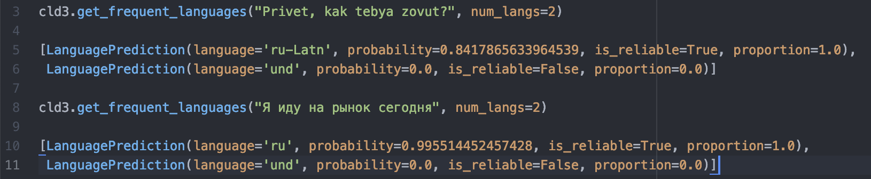
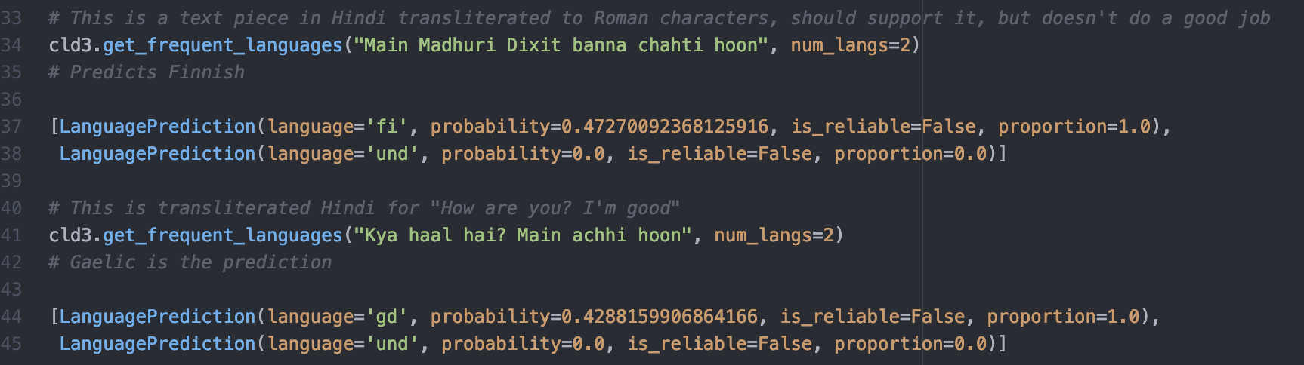
Language Identification: cld3
109 languages
Transliterated examples
Russian
"eo", "su", "uz", "zh-Latn", "ne", "nl", "sw", "sq", "hmn", "ja", "no", "mn", "so", "ko", "th", "kk", "sl", "ig", "mr", "zu", "ml", "pt", "yi", "lv", "iw", "cs", "vi", "jv", "be", "km", "mk", "tr", "la", "id", "fil", "sm", "ca", "el", "ka", "sr", "it", "sk", "ru", "ru-Latn", "et", "ms", "gd", "bg-Latn", "ha", "is", "ur", "mi", "hi", "bn", "hi-Latn", "fr", "hu", "lb", "el-Latn", "st", "ceb", "pl", "ja-Latn"
Hindi
Notes:
Cld3 algorithm works on the chrome browser to detect language of the content and it’s based on a very shallow neural network and uses the frequency of ngrams at the char level appearing in the input text
Encircled ones are languages that are transliterated – they include Chinese, Russian, Japanese, Hindi and Bulgarian
All of the frameworks are in Python and can be looked up from the notebook in the link provided,
Has a function called get frequent languages, in which we can specify number of top-k languages we want to see and this obviously based on probability, also gives the proportion of the text that is of that language
Transliterated -> hello what is your names?
Russian native: I'm going to the market today

Slide 11
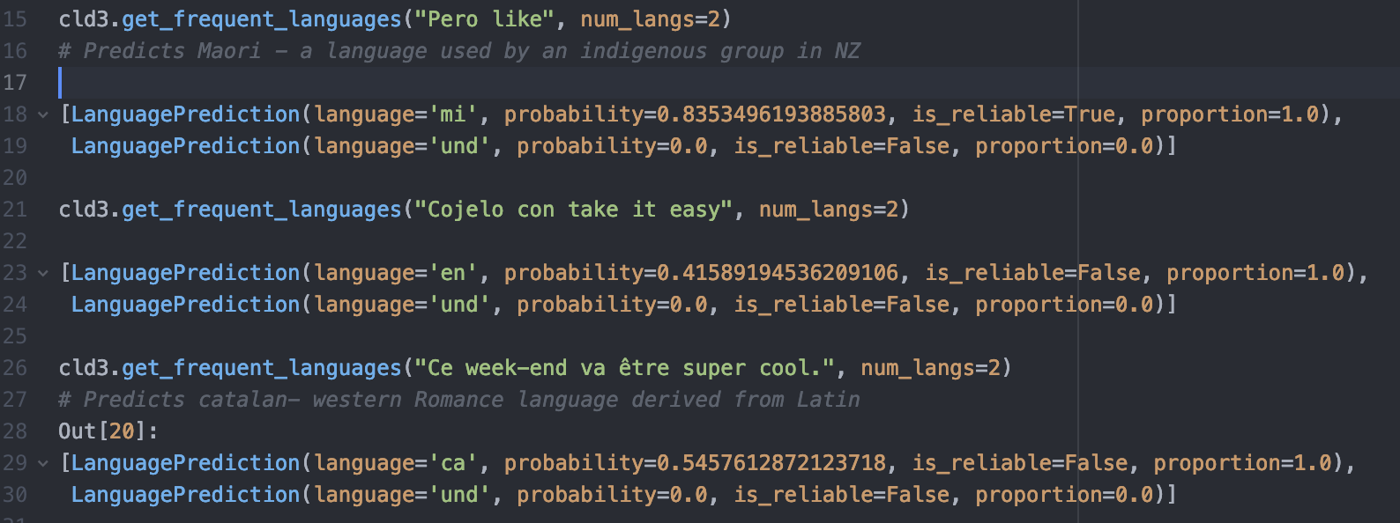
Language Identification: cld3
109 languages
Code-switched examples
"eo", "su", "uz", "zh-Latn", "ne", "nl", "sw", "sq", "hmn", "ja", "no", "mn", "so", "ko", "th", "kk", "sl", "ig", "mr", "zu", "ml", "pt", "yi", "lv", "iw", "cs", "vi", "jv", "be", "km", "mk", "tr", "la", "id", "fil", "sm", "ca", "el", "ka", "sr", "it", "sk", "ru", "ru-Latn", "et", "ms", "gd", "bg-Latn", "ha", "is", "ur", "mi", "hi", "bn", "hi-Latn", "fr", "hu", "lb", "el-Latn", "st", "ceb", "pl", "ja-Latn"
Spanish/French
Challenge # 1: Detecting text with Romanized script
Challenge #2: Small text length
Challenge #3: Slang/ borrowed words
Notes:
Pero=just, only in Spanish
"Chill, don't worry about it = cojelo con take it easy

Slide 12
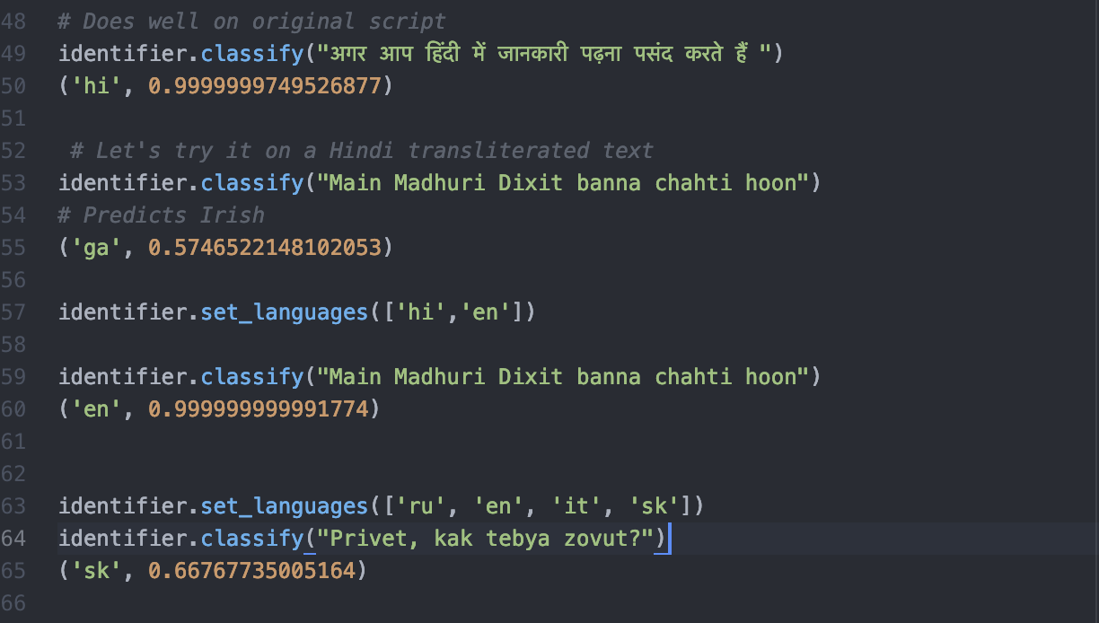
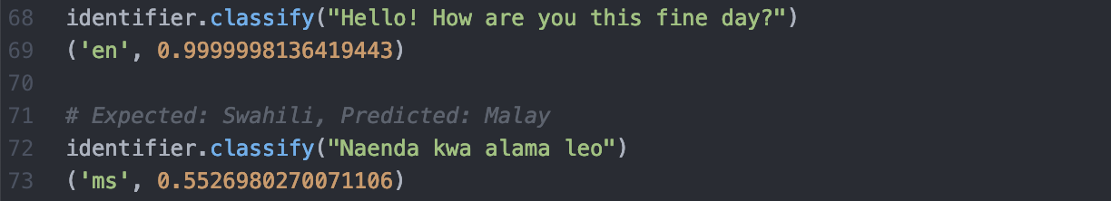
Language Identification: langid
97 languages
Transliterated examples
af, am, an, ar, as, az, cs, cy, da, de, dz, el, en, eo, es, et, hi, hr, ht, hu, hy, id, is, it, ja, ml, mn, mr, ms, mt, nb, ne, nl, nn, no, oc, or, pa, pl, ps, pt, qu, ro, ru, rw, se, si, sk, sl, sq, sr, sv, sw, ta, zh, zu,…
Hindi: Original script/transliterated
Underrepresented language
English vs Swahili
Russian transliterated
Challenge #4: Not trained for transliterated languages!
Challenge #5: Not enough data for underrepresented languages
Notes:
langid.py is trained over a naive Bayes classifier with a multinomial event model (McCallum and Nigam, 1998), over a mixture of byte n-grams (1≤n≤4).
Swahili: I’m going to the market today

Slide 13
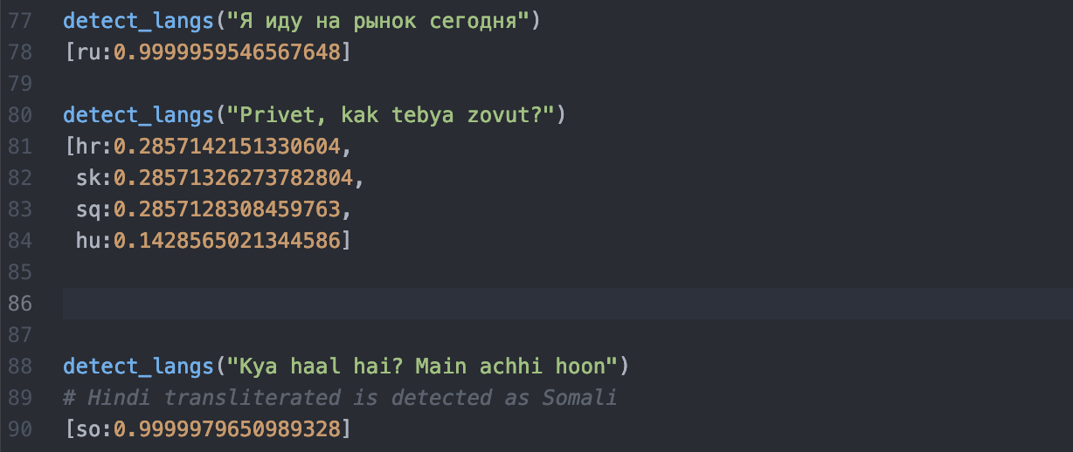
Language Identification: langdetect
Russian: Original script/transliterated
55 languages
af, ar, bg, bn, ca, cs, cy, da, de, el, en, es, et, fa, fi, fr, gu, he, hi, hr, hu, id, it, ja, kn, ko, lt, lv, mk, ml, mr, ne, nl, no, pa, pl, pt, ro, ru, sk, sl, so, sq, sv, sw, ta, te, th, tl, tr, uk, ur, vi, zh-cn, zh-tw
Hindi: transliterated
Not trained for transliterated languages!
Notes:
Naïve bayes classifier with character n-grams it.
Same example as before

Slide 14
How to Add Multilingual Support?
Notes:
Now that we’ve seen certain shortcomings, how do we overcome them? We’ll go over two ways, one is a little ad-hoc, the other is through pre-trained multilingual models that are fresh in the market – BERT

Slide 15
Build Annotated Datasets
WHY?
Not enough data available in your desired language
Do not want models trained on multiple languages to bring in noise
Identify data source in any language that can be translated to desired language by rules/ machine
Use this machine generated data to augment
HOW?
New Dataset
EXAMPLE
Dump of Hindi Wiki articles
+
Transliterate
(Optional) Small Dataset
Rule based transliterator
Notes:
For really task specific problems, or languages that have no representation in any pretrained models, this is an easy approach

Slide 16
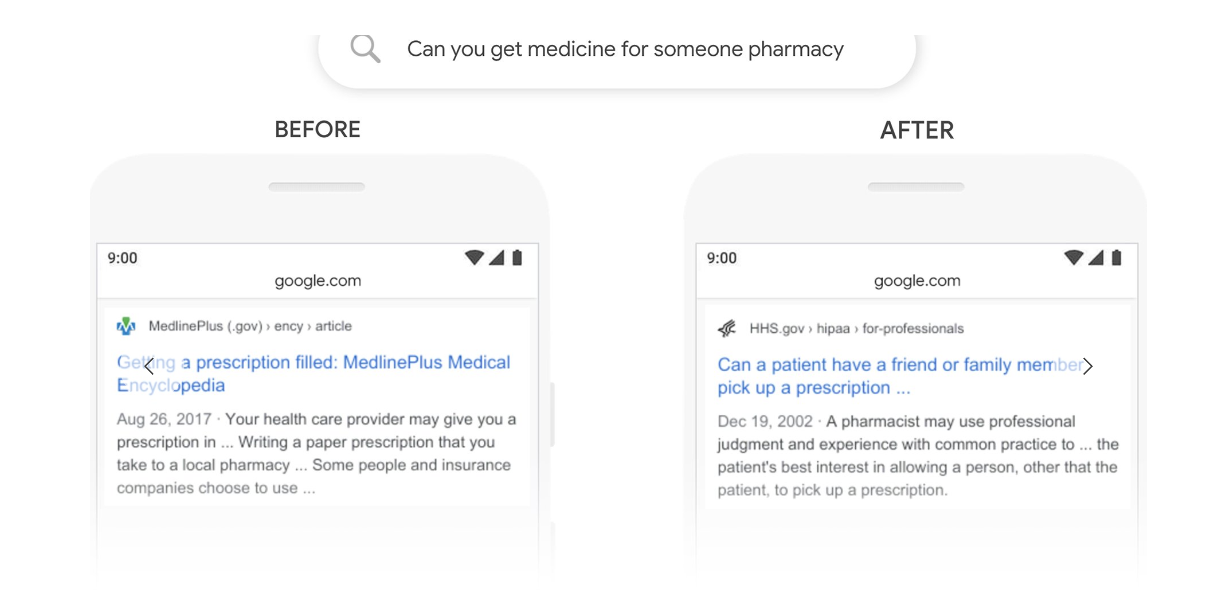
BERT: Bidirectional Encoder Representations from Transformers
Helps in language understanding!
Bidirectional
Looks at all words in the input text
Source: https://blog.google/products/search/search-language-understanding-bert/
Notes:
- Transformer based model released in 2019, a new language representation model
More relevant search results on top by using bert embedding vectors, semantic search , which words more important, which words to pay attention to?

Slide 17
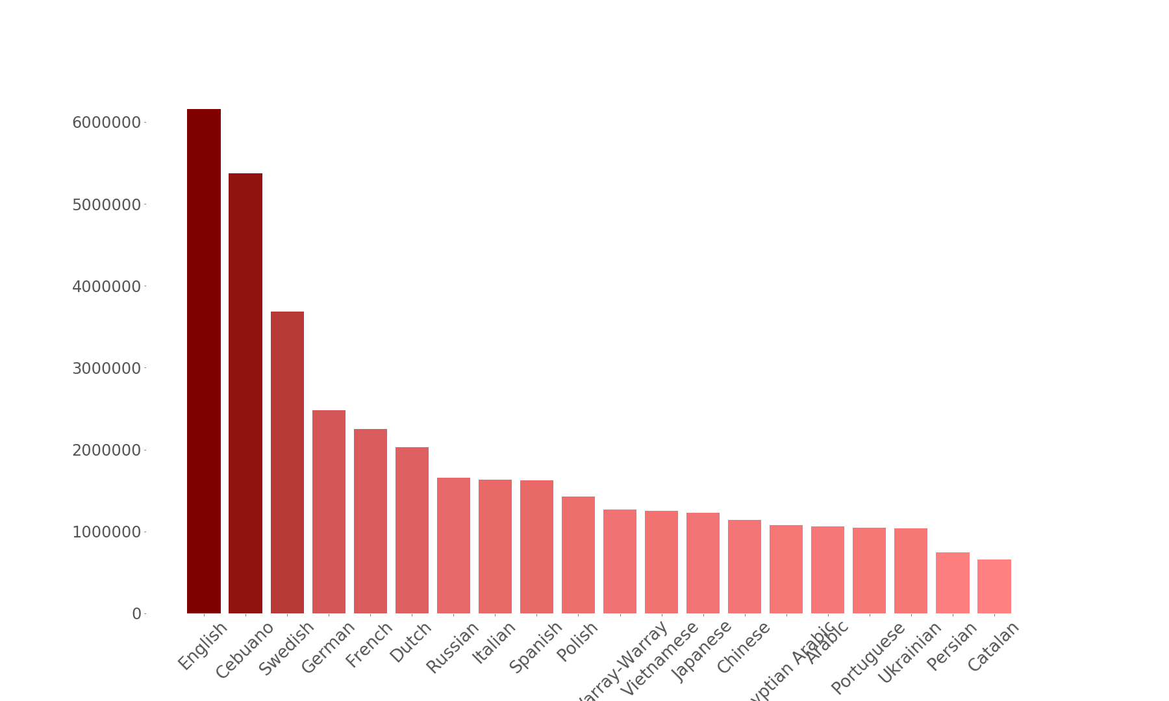
BERT: Languages distribution
Number of Wikipedia Articles in top 20 languages
Exponential smoothed weighting of data
Eg. English vs Tibetan
With original Wiki data size: 1000x more
After normalization: 100x more
Tibetan: ~6k articles
Data Source: https://meta.wikimedia.org/wiki/List_of_Wikipedias
Notes:
let's say that the probability of a language is P(L), e.g., P(English) = 0.21 means that after concatenating all of the Wikipedias together, 21% of our data is English. We exponentiate each probability by some factor S and then re-normalize, and sample from that distribution.

Slide 18
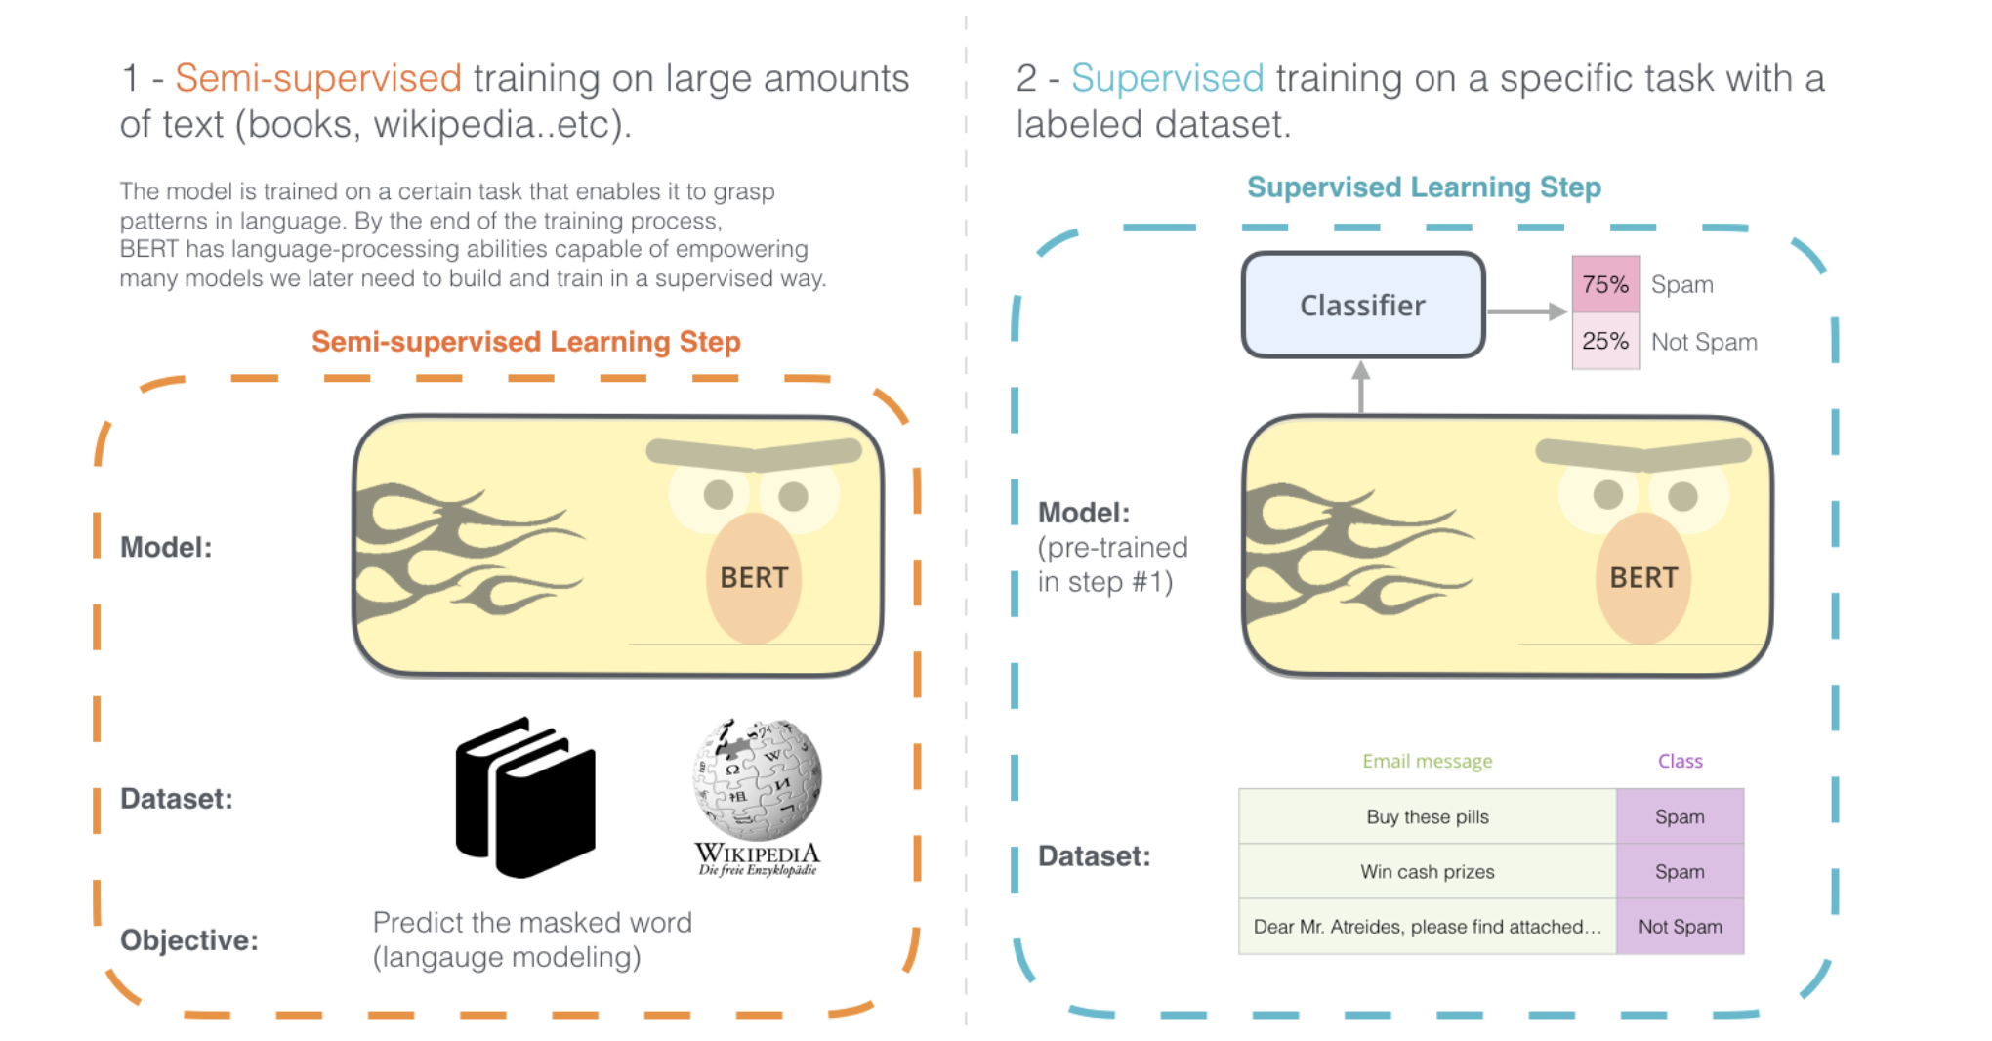
BERT: Why is it Special?
Pre-training: Train on unlabeled data
Next sentence prediction
True label: IsNext 50% of the time
False Label: as NotNext
Masked LM
Fine-tuning: Initialize with pre-trained weights and fine-tune for task with labeled data
Fine-tune for any task!
Question –answering
Classification
Sequence tagging
Sentence paraphrase detection
Source: http://jalammar.github.io/illustrated-bert/
Notes:
- try to make it as knowledgeable as possible

Slide 19
BERT: Language Model
Masked Input text
Bert-base-multilingual-cased
Predicted words for masked tokens
['¡’]
['...’]
['Viva’]
['Vive’]
['Hasta'] ['dejar’]
['Dar'] ['empezar'] ['Gracias’]
['volver’]
['Por']
live
This is what I want to say to everyone out there - vivir y dejar vivir!
until
start
return
Mask & Predict

Slide 20
BERT: Language Model
Masked Input text
Bert-base-multilingual-cased
Predicted words for masked tokens
['no’]
['solo’]
['non’]
['bien'] ['nunca’]
['yo’]
['a’]
['sólo'] ['también'] ['hacer’]
[',']
just
well
This is what I want to say to everyone out there - vivir y dejar vivir!
also
Mask & Predict

Slide 21
BERT: Language Model
Masked Input text
Bert-base-multilingual-cased
Predicted words for masked tokens
['blog’]
['Blog'] ['publisher'] ['forum’]
['tag’]
['poster'] ['photographer]
['peer'] ['reporter'] ['guru'] ['pseudonym']
अगर आप हिंदी में जानकारी पढ़ना पसंद करते हैं तो आपको best hindi blogs यानी भारत में popular Hindi bloggers कौन-कौन से हैं … हिंदी में blog पढ़ना पसंद करते हैं लेकिन … कुछ popular Hindi blogs list होने चाहिए।
Mask & Predict

Slide 22
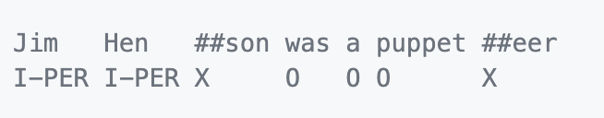
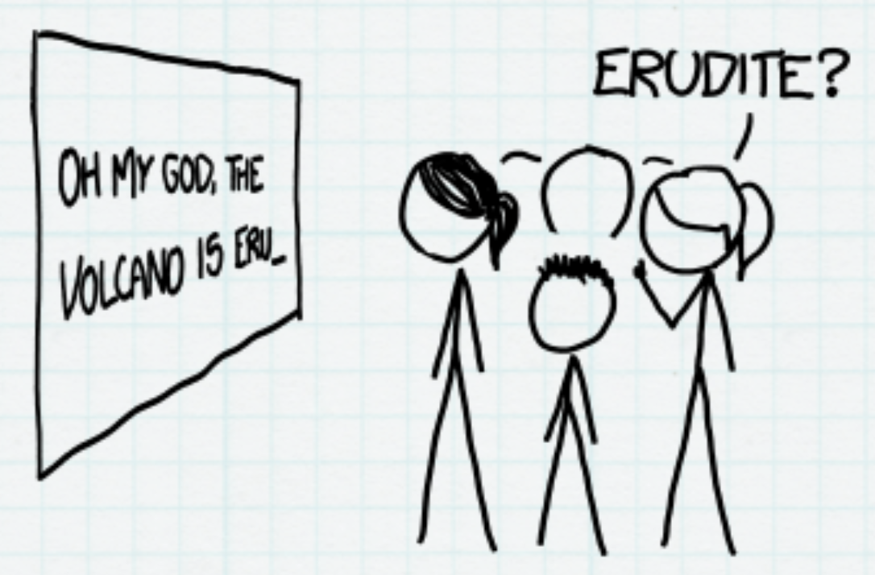
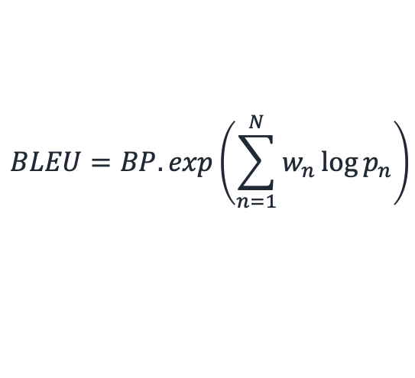
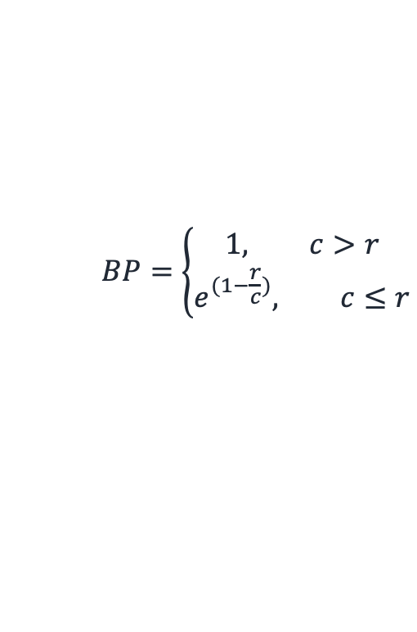
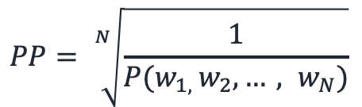
How to Evaluate Performance on Tasks?
Language modeling: Perplexity
Translation: BLEU Score
POS Tagging/ Classification
BLEU score
Here, c = candidate length
r = reference length
w_{n} = weights of n-gram
p_{n} = modified precision of n-gram
NOT PREDICTED!
$$BP=\left\{\begin{aligned}1, c>r \\ &e^{(1−\frac{r}{c})}, c≤r\end{aligned}\right.$$
Source: https://thegradient.pub/understanding-evaluation-metrics-for-language-models/
$$PP= \sqrt[N]{\frac{1}{P(w_{1, }w_{2},…, w_{N})}}$$
$$BLEU=BP.exp\left(\sum_{n=1}^{N}{w_{n}}\log{p_{n}}\right)$$
Source: https://github.com/soutsios/pos-tagger-bert
Notes:
A language model is a probability distribution over sentences. perplexity is a measurement of how well a probability model predicts a sample. – for any piece of multilingual text, it’s good to evaluate the language model on this metric
Bilingual Evaluation - from any underrepresented language, any code switched data as well, approach counting matching n-grams in the candidate translation to n-grams in the reference text
Pos tagging for various purposes, confusion matrix, and one thing to note about pos tagging that the paper authors did is that not every word as such is classified, only the first sub-token is. For classification metrics, we can look at confusion matrix, metrics like per class recall/F1 score etc., precision

Slide 23
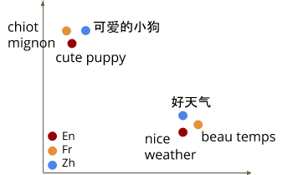
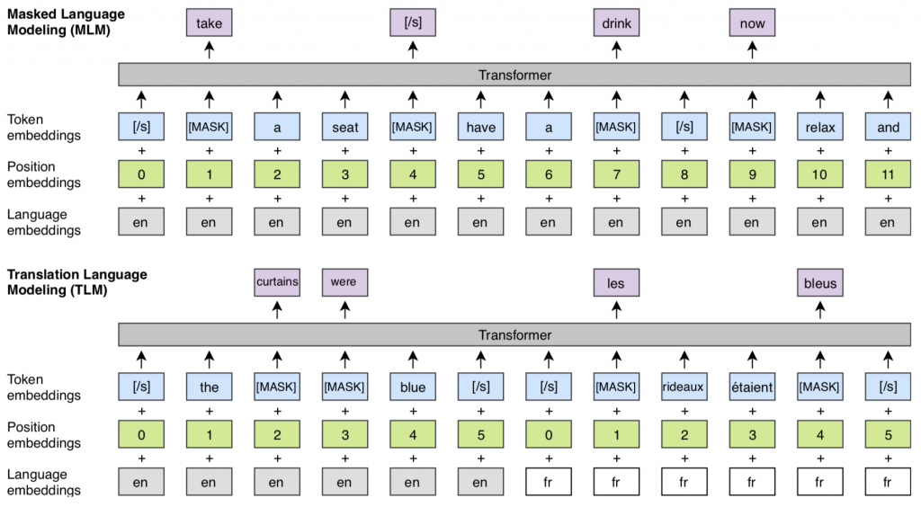
What Are We Excited About?
Language Agnostic Representations
Cross-Language Modeling
Source: https://ai.googleblog.com/2020/08/language-agnostic-bert-sentence.html
Source: XLM Paper (https://arxiv.org/abs/1901.07291)
Notes:
multilingual embedding model is a powerful tool that encodes text from different languages into a shared embedding space, from here we could potentially do text classification anything, these include multilingual Universal sentence encoder and FB’s Laser, potentially these can lead to a better language understanding
Cross lingual language models are very interesting – this was again introduced by FB after BERT’s success in intensive pre-training, they show that cross-lingual language models can provide significant improvements on the perplexity of low-resource languages. The TLM objective extends MLM to pairs of parallel sentences. To predict a masked English word, the model can attend to both the English sentence and its French translation, and is encouraged to align English and French representations

Slide 24
https://github.com/ShreyaKhurana
Notes:
Give you an idea about what was, what is, and what's coming up in this multilingual space,

Slide 25
References
http://jalammar.github.io/illustrated-word2vec/
http://jalammar.github.io/illustrated-bert/
https://nlp.stanford.edu/projects/glove/
https://github.com/saffsd/langid.py
https://pypi.org/project/langdetect/
https://github.com/google/cld3
https://blog.google/products/search/search-language-understanding-bert/
https://github.com/soutsios/pos-tagger-bert
https://ai.googleblog.com/2019/07/multilingual-universal-sentence-encoder.html
https://ai.googleblog.com/2020/08/language-agnostic-bert-sentence.html
https://github.com/google-research/bert/
XLM Paper: Lample, Guillaume, and Alexis Conneau. "Cross-lingual language model pretraining." arXiv preprint arXiv:1901.07291 (2019).
BERT Paper: Devlin, Jacob, et al. "Bert: Pre-training of deep bidirectional transformers for language understanding." arXiv preprint arXiv:1810.04805 (2018).

